Slide 1
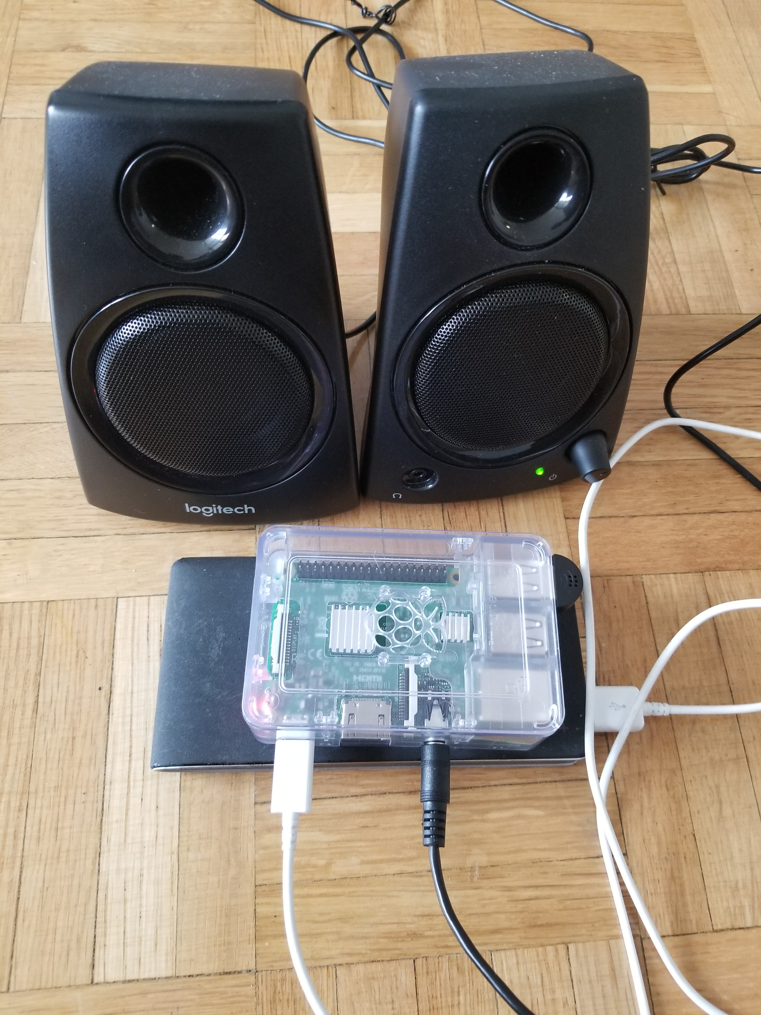
USB – Microphone Using Alexa Skills Piyush Rana N01143461

Slide 2
Introduction
USB Microphone is based on the Alexa skills by Amazon.
It can be used to gain information about weather, news, time, etc.
This can also be connected to control the home devices like music player, AC, Heaters, etc.

Slide 3
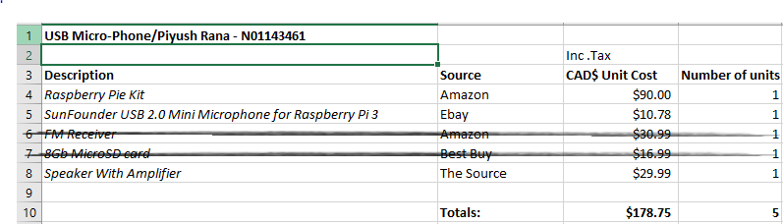
BuDget
I ended up not buying FM Receiver as I switch from wireless to USB microphone.
For MicroSD card, I found it in my old phone so I did not buy it.

Slide 4
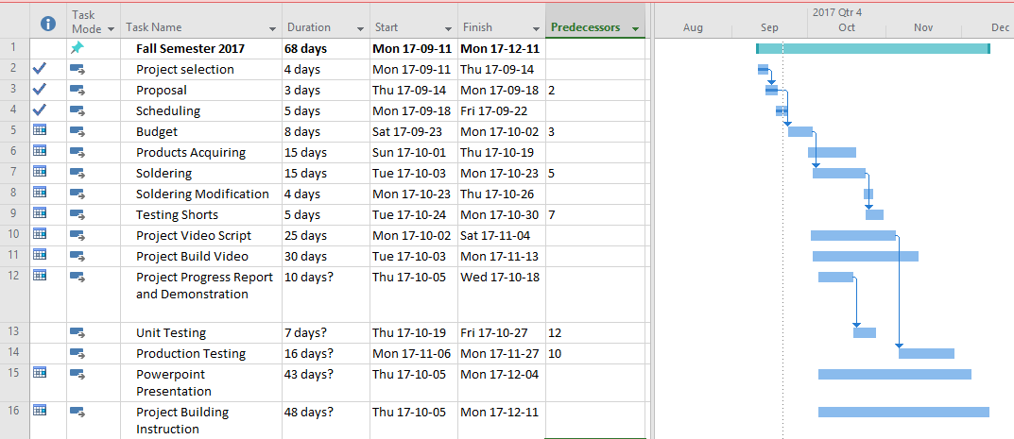
Project outline
Due to strike in our college, the semester was extended.
Finished the project before Winter holidays.
It can take few hours to build this project with all build instruction provided.
All testing of the project is complete.
2

Slide 5
Build video with working sensor
Below is the link to the video on my GitHub.
https://github.com/PRana02/USB-Microphone-Alexa-Skills-Based-/blob/master/Final%20Movie.mp4

Slide 6
Knowledge Utilized from previous courses
TECH 150 : We got familiar with the electric circuits and its application.
TECH 153 : We learned to get started with Raspberry Pi and its functionalities.
CENG 216 : Utilization of Gantt Charts and keeping your work updated according to the due time.
In this course, we learned in detail about the raspberry Pi, connecting sensors to it and controlling it remotely.
We also learned the effective use of GitHub.
At the end of this course, we got an idea of the practical world.

Slide 7
Thank You.!

